Slide 1

Video Game Sales
Cory Swisler
Irfanullah Ghaffar
Anthony Thepsourinthone

Slide 2

Objectives
Video Game Sales in the U.S.
Using Machine Learning to predict the future Sales.

Slide 3
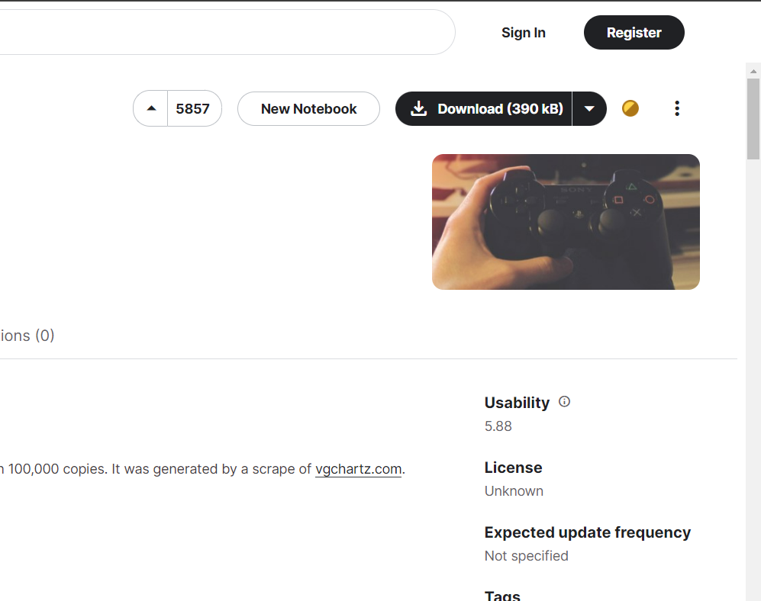
KAGGLE

Slide 4

CSV Files
Python Pandas
NumPy
SkLearn
Matplotlib
Data Cleanup
Analyzation
Decision Tree
Tableau
Data Visualization

Slide 5
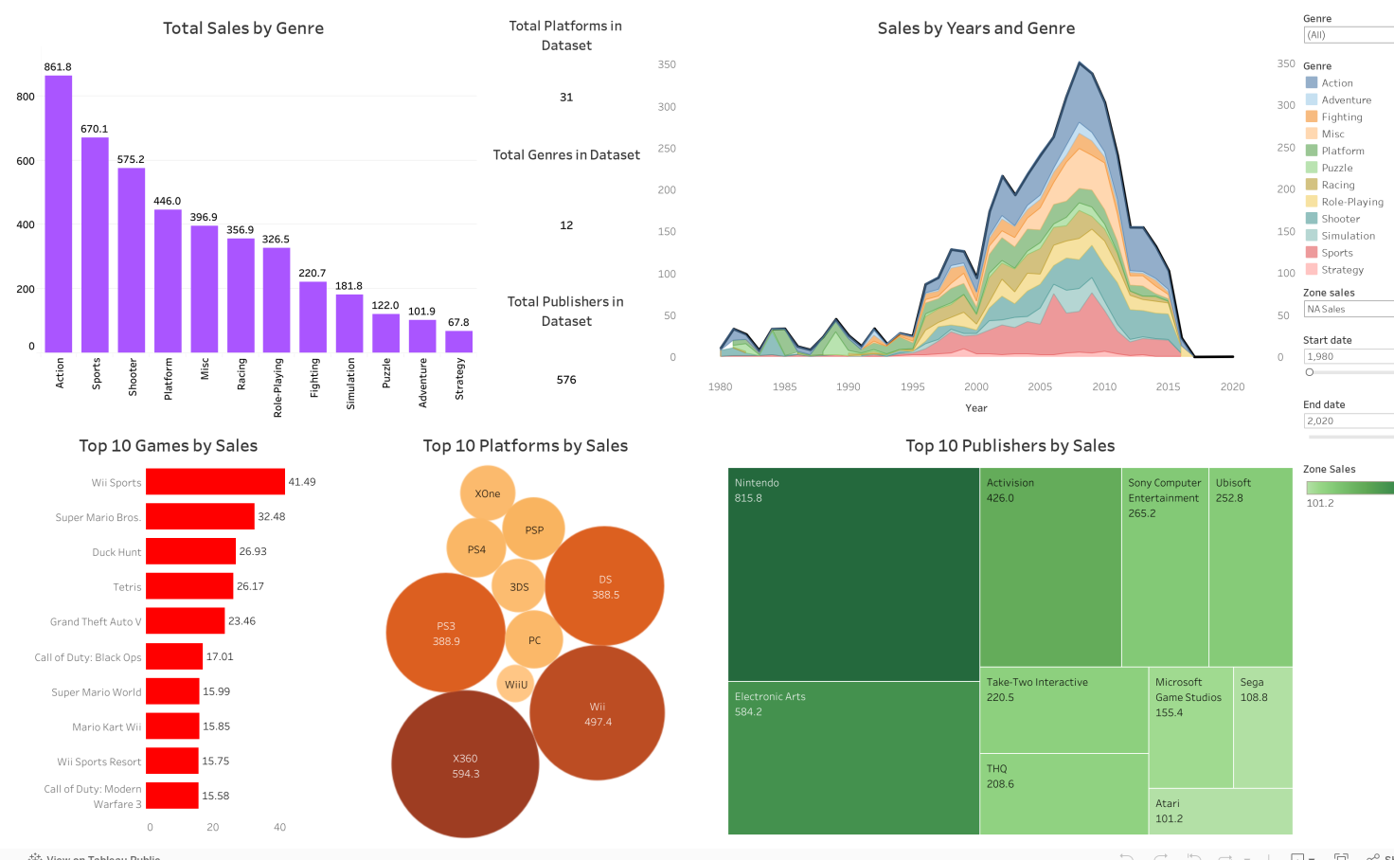
Tableau

Slide 6
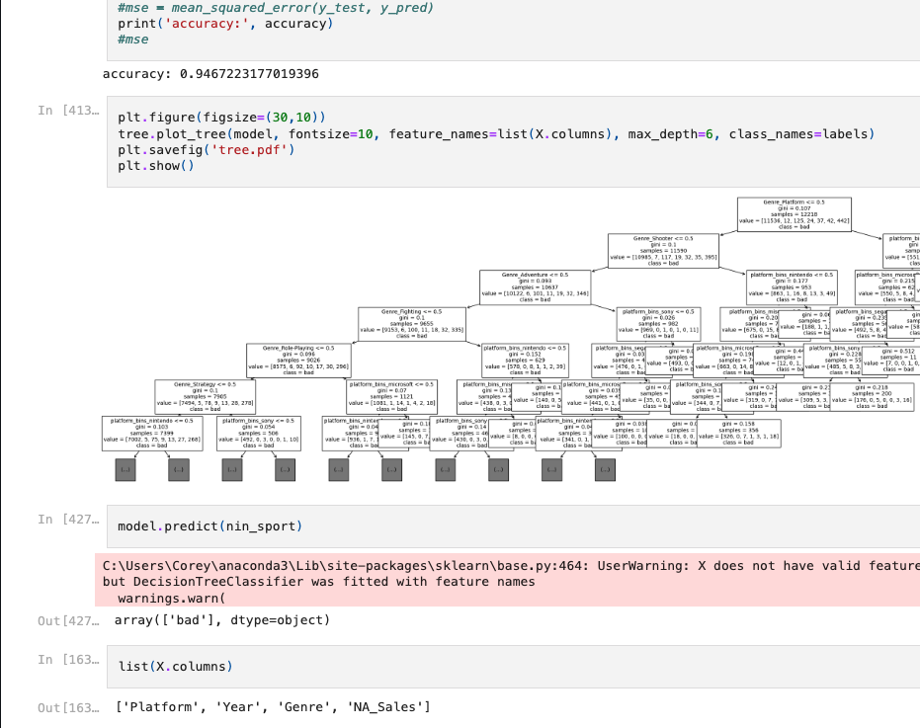
Python Pandas

Slide 7
Questions?

Slide 8
Thank you!

